Slide 1

09 - Naïve Bayes Classifier
1
1

Slide 2
Course Overview:
1.1 - Python Review
1.2 - Numpy
1.3 - Pandas
1.4 - Seaborn
2.1 - ML Intro
2.2 - Linear Regression
2.3 - Logistic Regression & others
2.4 - K-NN
2.5 - Decision Trees
2.6 - Neural Networks
3.1 – Ensembling Learning: XGBoost
3.2 Competition Tips & Final Thoughts
4.* - Natural Language Processing (NLP): Random Forers, SVM, Naïve Bayes

Slide 3
Course Overview:
1.1 - Python Review
1.2 - Numpy
1.3 - Pandas
1.4 - Seaborn
2.1 - ML Intro
2.2 - Linear Regression
2.3 - Logistic Regression
2.4 -Naïve Bayes Classifier
2.5 - KNN
2.6 - Decision Trees
3.1 – Ensembling Learning
3.2 - Neural Networks
4.* - Natural Language Processing (NLP)
5.* Competition Tips & Final Thoughts

Slide 4
What are Naïve Bayes classifiers?
What are Naïve Bayes classifiers?
The Naïve Bayes classifier is a supervised machine learning algorithm that is used for classification tasks such as text classification. They use principles of probability to perform classification tasks.
Naïve Bayes is part of a family of generative learning algorithms, meaning that it seeks to model the distribution of inputs of a given class or category. Unlike discriminative classifiers, like logistic regression, it does not learn which features are most important to differentiate between classes.

Slide 5
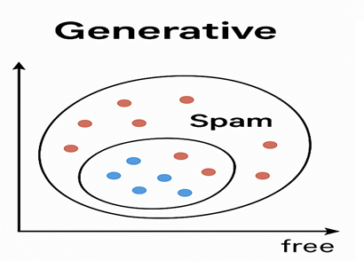
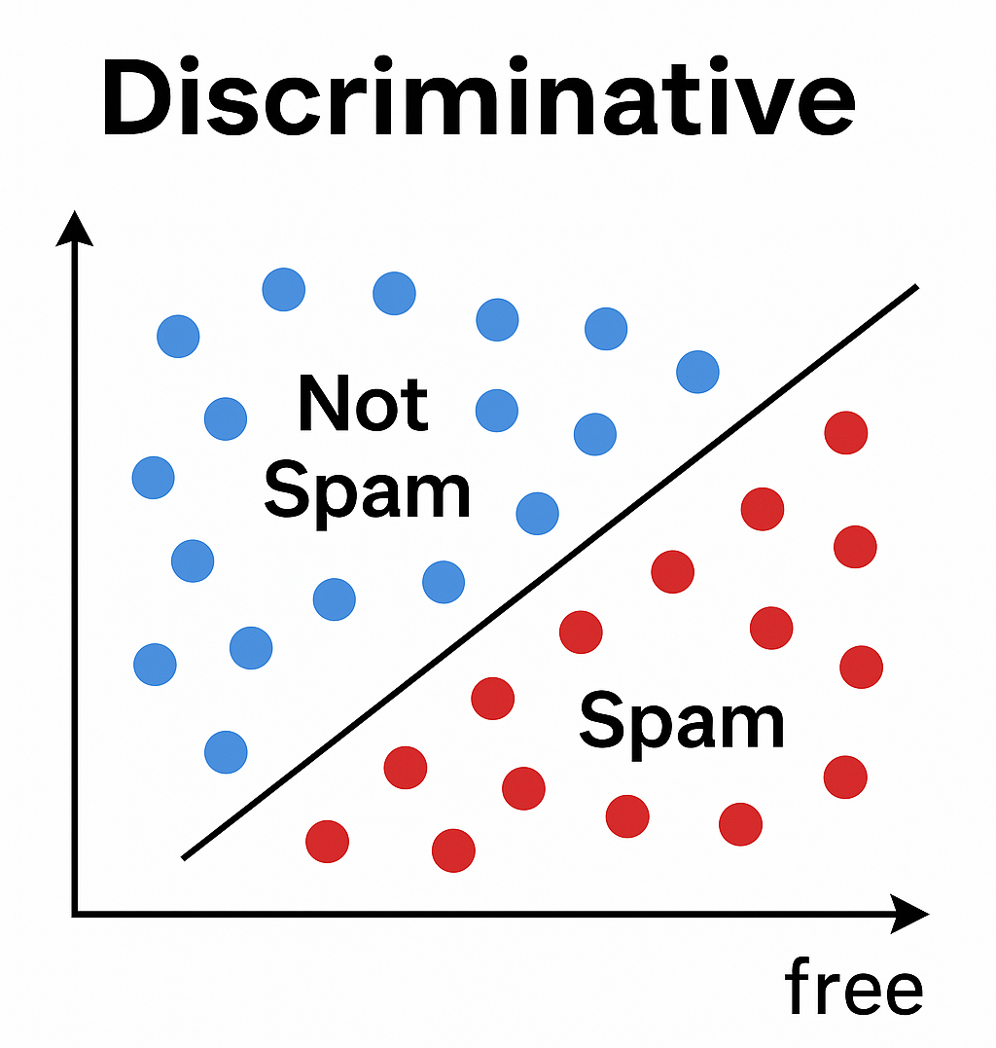

Slide 6
Why is it called Naïve Bayes?
Naïve: The algorithm is called naïve because it assumes that all features (predictors) are independent of each other given the class label.
Example: When classifying a fruit, the features like color, shape, and taste are assumed to independently contribute to identifying the fruit — even though in reality, they may be related.
Bayes: The algorithm is based on Bayes’ Theorem, which provides a way to compute the posterior probability of a class given observed features.

Slide 7
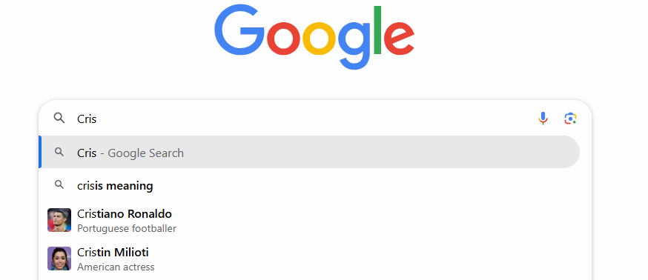

Slide 8
Bayes' Theorem helps calculate the posterior probability using the formula:
P(A | B) = [P(B | A) * P(A)] / P(B)
Where:
P(A | B): Posterior probability (the probability of A, given B)
P(B | A): Likelihood (the probability of B, given A)
P(A): Prior probability (the initial probability of A)
P(B): Evidence (the total probability of B)
Question: What is the probability that an email is spam, given that it contains the word "FREE"?

Slide 9
We use Bayes' Theorem to calculate:
P(Spam|"FREE") = P("FREE"|Spam) × P(Spam) / P("FREE")
Event | Probability
P(Spam) | 20% of emails are spam
P(Not Spam) | 80% are not spam
P("FREE"∣Spam) | 70% of spam emails contain "FREE"
P("FREE"∣Not Spam) | Only 1% of non-spam emails contain "FREE"

Slide 10

Bayes' Theorem helps calculate the posterior probability using the formula:
Where:
P(A | B): Posterior probability (the probability of A, given B)
P(B | A): Likelihood (the probability of B, given A)
P(A): Prior probability (the initial probability of A)
P(B): Evidence (the total probability of B)
In binary classification (e.g., spam or not spam):
P(B) = P(B ∣ Spam)⋅P(Spam)+P(B ∣ Not Spam)⋅P(Not Spam)

Slide 11
P(Spam|"FREE") = P("FREE"|Spam) × P(Spam) / P("FREE")
=0.7*0.2/ P("FREE")(which is not provided )
Evidence (Overall probability of seeing "FREE"), which is a binary classification:
P(B)=P(B∣spam)⋅P(spam)+P(B∣not spam)⋅P(not spam)
𝑃("FREE")=𝑃("FREE"∣Spam)⋅𝑃(Spam)+𝑃("FREE"∣Not Spam)⋅𝑃(Not Spam)
=(0.7⋅0.2)+(0.01⋅0.8)=0.14+0.008=0.148=(0.7⋅0.2)+(0.01⋅0.8)=0.14+0.008=0.148

Slide 12
P(Spam|"FREE") = P("FREE"|Spam) × P(Spam) / P("FREE")
=0.7*0.2/ 0.148
=94.6%
CONSLUSION
If an email contains the word "FREE", then the probability it is spam is approximately 94.6%.

Slide 13
Applications of Naïve Bayes Classifier
Spam Filtering
One of the most well-known use cases
Classifies emails as “spam” or “not spam” based on word probabilities
Document Classification
Assigns documents or articles to predefined categories
Common in news websites to auto-classify content (e.g., politics, sports, tech)
Sentiment Analysis
Determines whether a text expresses positive, negative, or neutral sentiment
Widely used in marketing and customer feedback analysis
Mental State Prediction
Uses fMRI brain scan data to predict cognitive states
Supports research in neuroscience and brain injury rehabilitation

Slide 14
Example of Naïve Bayes Classifier
Email | offer | money | click | label
1 | 1 | 1 | 1 | Spam
2 | 1 | 0 | 1 | Spam
3 | 0 | 1 | 1 | Spam
4 | 1 | 1 | 0 | Spam
5 | 1 | 0 | 0 | Not Spam
6 | 0 | 1 | 0 | Not Spam
7 | 0 | 0 | 1 | Not Spam
8 | 0 | 0 | 0 | Not Spam

Slide 15
Class | Count | Prior P(C)
Spam | 4 | 4/8 = 0.5
Not Spam | 4 | 4/8 = 0.5
Calculate Prior Probabilities
Calculate Conditional Probabilities (with Laplace Smoothing)
Feature | Class | Present Count | P(word = 1 | class)
offer | Spam | 3 | (3+1)/(4+2) ≈ 0.667
offer | Not Spam | 1 | (1+1)/(4+2) ≈ 0.333
money | Spam | 3 | (3+1)/(4+2) ≈ 0.667
money | Not Spam | 1 | (1+1)/(4+2) ≈ 0.333
click | Spam | 3 | (3+1)/(4+2) ≈ 0.667
click | Not Spam | 1 | (1+1)/(4+2) ≈ 0.333

Slide 16
New Email for Prediction
Feature | Value
Offer | 1
Money | 0
click | 1
For Spam: P(Spam) = 0.5 Likelihoods (with Laplace smoothing): P(offer = 1 | Spam) = 4 / 6 P(money = 0 | Spam) = 2 / 6 P(click = 1 | Spam) = 4 / 6 Score(Spam): = 0.5 × 4/6 × 2/6 × 4/6 ≈ 0.5 × 0.667 × 0.333 × 0.667 ≈ 0.074 | For Not Spam: P(Not Spam) = 0.5 Likelihoods (with Laplace smoothing): P(offer = 1 | Not Spam) = 2 / 6 P(money = 0 | Not Spam) = 4 / 6 P(click = 1 | Not Spam) = 2 / 6 Score(Not Spam): = 0.5 × 2/6 × 4/6 × 2/6 ≈ 0.5 × 0.333 × 0.667 × 0.333 ≈ 0.037
Score(Spam) > Score(Not Spam) → the email is classified as Spam

Slide 17
New Email for Prediction (Final Exam Question)
Feature | Value
Offer | 1
Money | 1
click | 1
For Spam: P(Spam) = 0.5 Likelihoods (with Laplace smoothing): P(offer = 1 | Spam) = 2/4 → 4 / 6 P(money = 0 | Spam) = 2 / 6, P(money = 1 | Spam) = 3 / 4→ 4 / 6 P(click = 1 | Spam) = 3/ 4 → 4 / 6 Score(Spam): = 0.5 × 4/6 × 4/6 × 4/6 ≈ 0.5 × 0.667 × 0.667 × 0.667 ≈ 0.298=0.15 | For Not Spam: P(Not Spam) = 0.5 Likelihoods (with Laplace smoothing): P(offer = 1 | Not Spam) = 1/4 → 2 / 6 P(money = 0 | Not Spam) = 4 / 6, P(money = 1 | Not Spam) = 1 / 4→ 2/6 P(click = 1 | Not Spam) = 1 / 4 → 2 / 6 Score(Not Spam): = 0.5 × 2/6 × 2/6 × 2/6 ≈ 0.5 × 0.333 × 0.333 × 0.333 ≈ 0.037
Score(Spam) > Score(Not Spam) → the email is classified as Spam

Slide 18
Advantages of Naïve Bayes
Less Complex
Easy to implement and interpret
Parameters are simple to estimate
Often one of the first models taught in ML courses
Scales Well
Fast and efficient, especially when the conditional independence assumption holds
Lower memory/storage requirements compared to models like logistic regression
Handles High-Dimensional Data
Works well with large feature spaces (e.g., in document classification)

Slide 19
Disadvantages of Naïve Bayes
Zero Frequency Problem
If a word or feature never appears in the training data for a given class, its probability becomes zero
This leads to a posterior probability of zero, breaking the model
Solution: Use Laplace Smoothing to handle unseen features
Unrealistic Assumption of Feature Independence
Assumes all features are conditionally independent given the class
In real-world data, this is often not true, which can lead to inaccurate classifications

Slide 20
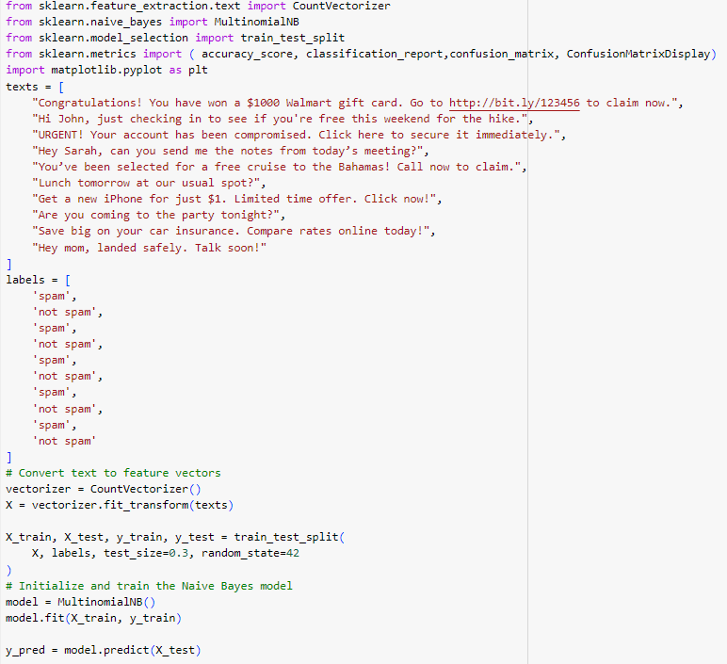
example IN CODE

Slide 21
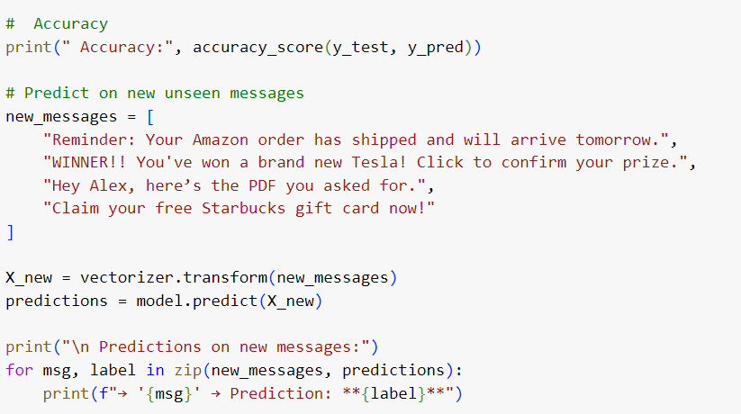

Slide 22
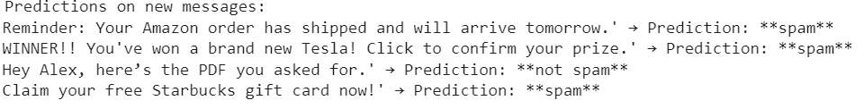

Slide 23
THANKS
23

